Slide 1
Transformational
Healing and
Responses to
Inform
Violence
Education:
An Introduction to
THRIVE Technical Assistance
New Grantee Orientation
San Diego, CA
December 10-12, 2024
This project was supported by Grant No. 15JOVW-23-GK-05156-MUMU awarded by the Office on Violence Against Women, U.S. Department of Justice. The opinions, findings, conclusions, and recommendations expressed in this publication/program/exhibition are those of the author(s) and do not necessarily reflect the views of the Department of Justice, Office on Violence Against Women.

Slide 2
Who we are as individuals
Who we are as organizations
Agenda
The values that impact our approach and mission
Types of Technical Assistance
How to get a hold of us?

Slide 3
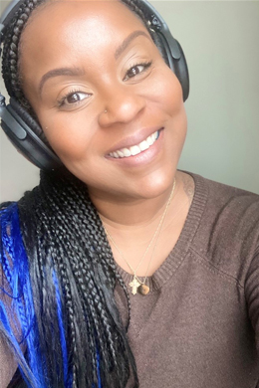
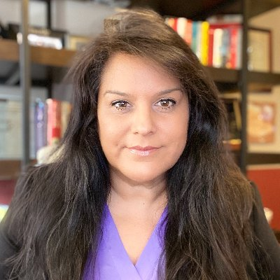
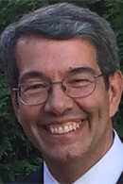
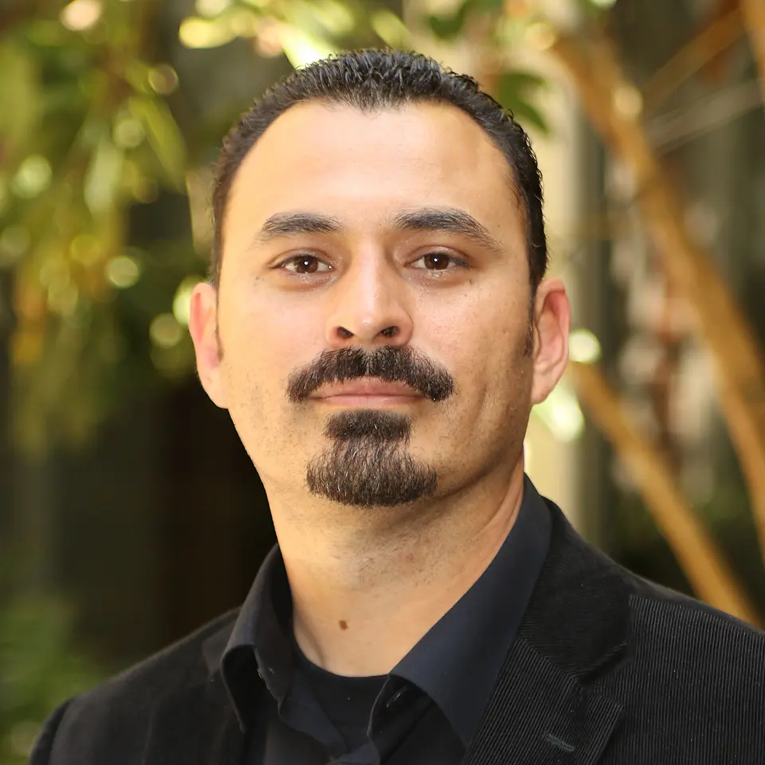
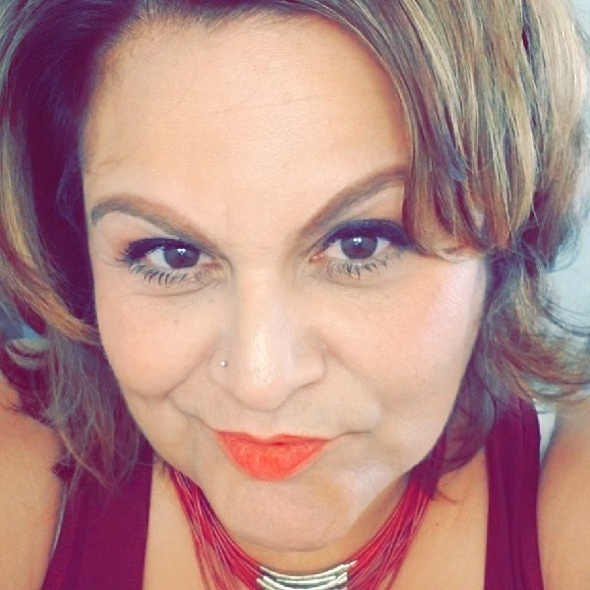
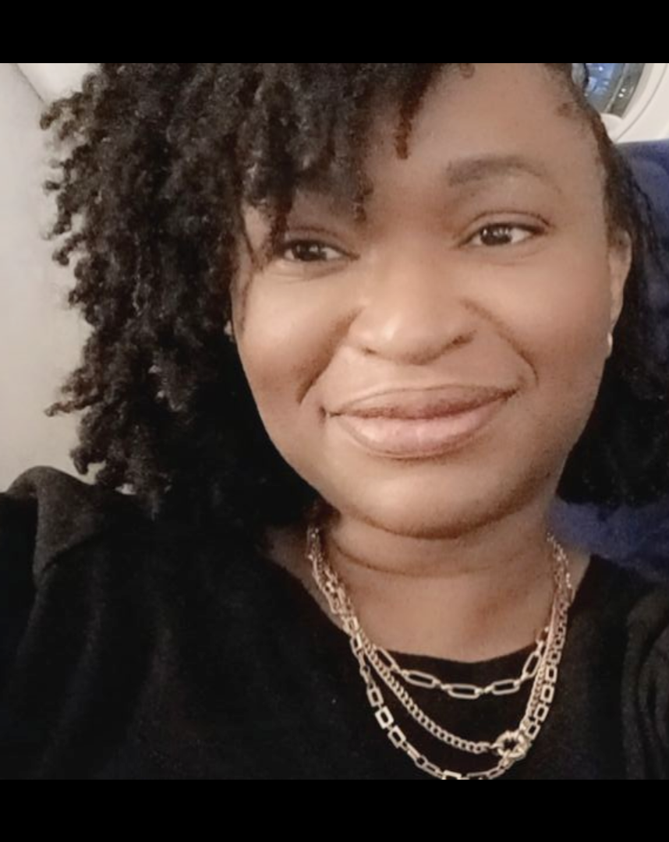
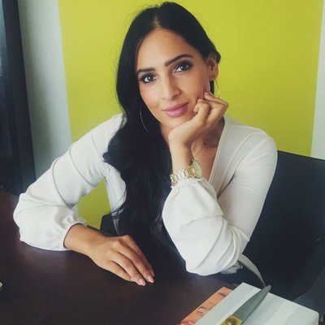
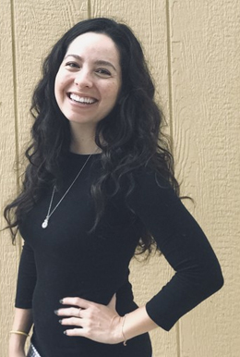
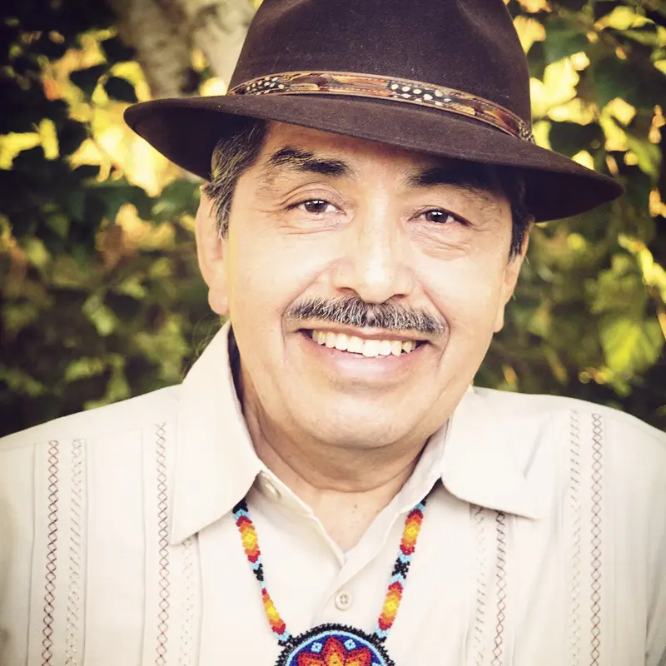
Meet Our THRIVE TA Team
Wendy Mota
Ruby White Starr
Juan Carlos Areán
Ozzie Cruz
Zandra Lopez
CL-LUPE
CL-LUPE
FUTURES
National Compadres Network
CL-LUPE
Nivea Castaneda
Acrey
Mie Fukuda
Lonna Davis
Jerry Tello
Izzy Medina
CL-LUPE
FUTURES
FUTURES
National Compadres Network
CL-LUPE
Notes:
The Responses to Inform Violence Education
Transformational Healing Responses to Inform Violence Education

Slide 4
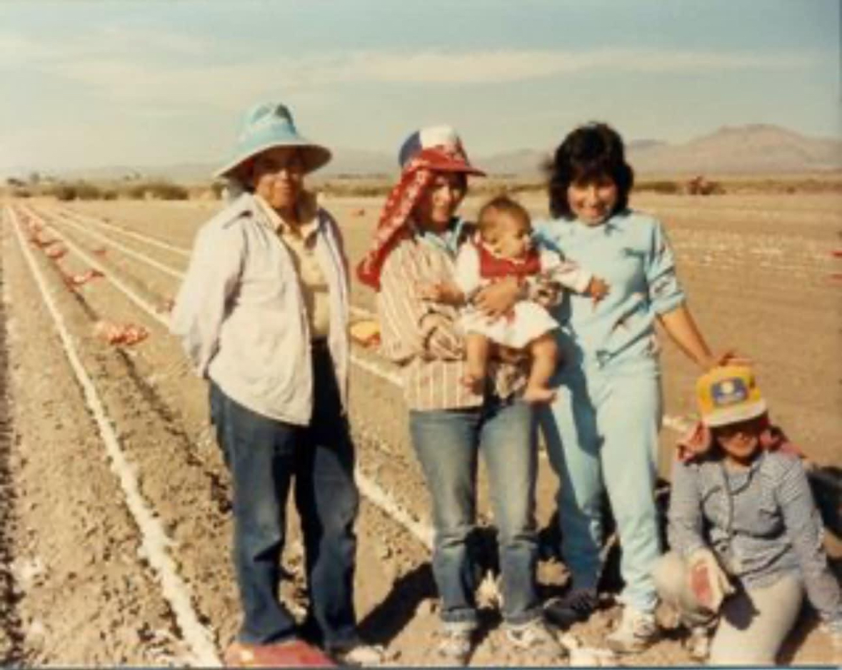
Nivea Castañeda Acrey Caminar Latino-Latinos United for Peace and Equity

Slide 5
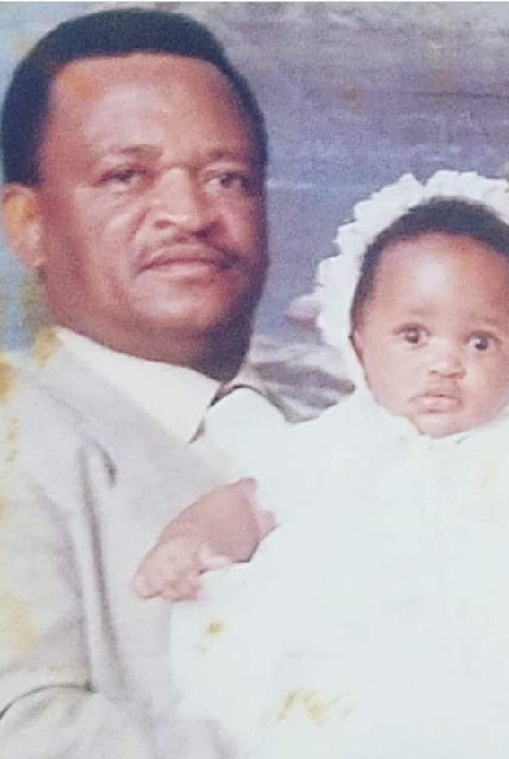
Izzy Medina Caminar Latino- Latinos United for Peace and Equity

Slide 6
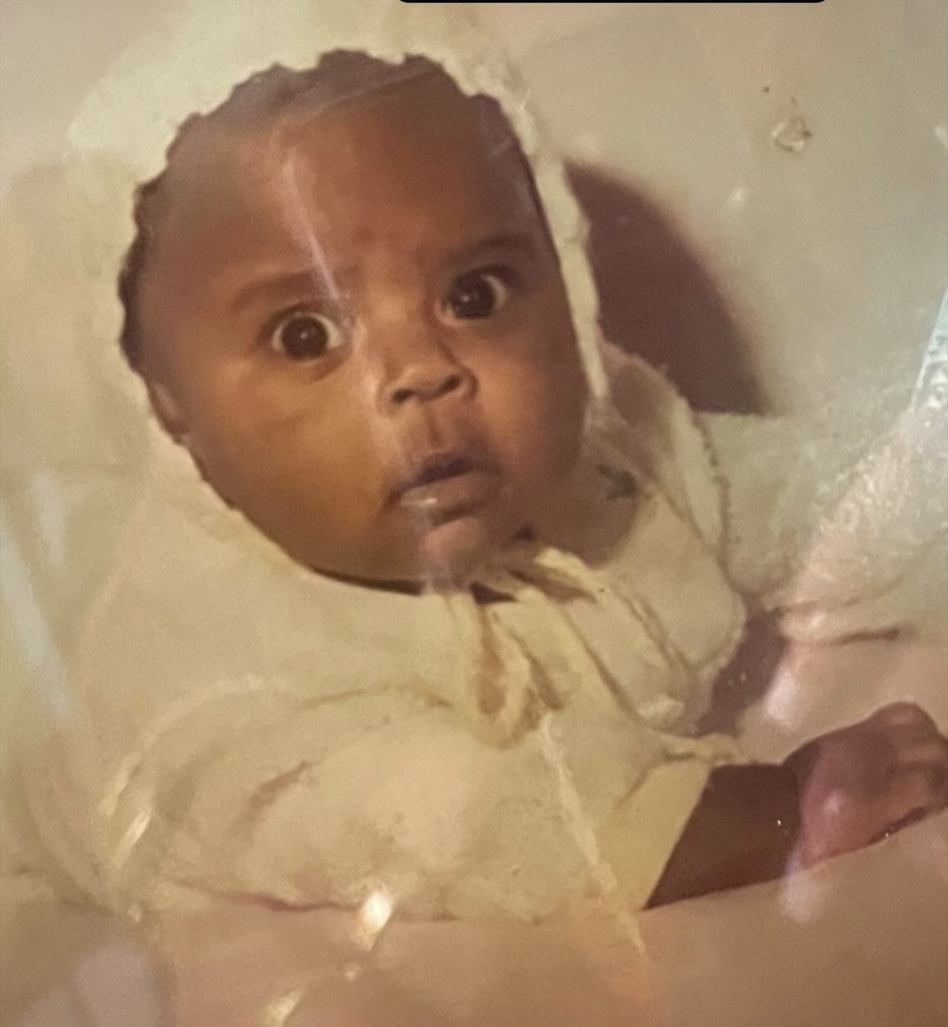
Wendy Mota Caminar Latino-Latinos United for Peace and Equity

Slide 7
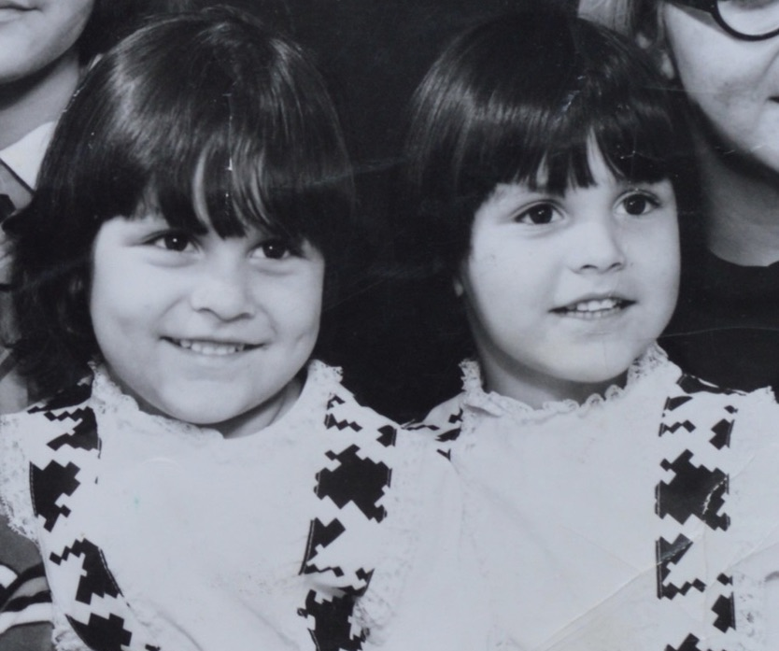
Ruby White Starr Caminar Latino- Latinos United for Peace and Equity

Slide 8
Ozzie Cruz National Compadres Network

Slide 9
Jerry Tello National Compadres Network

Slide 10
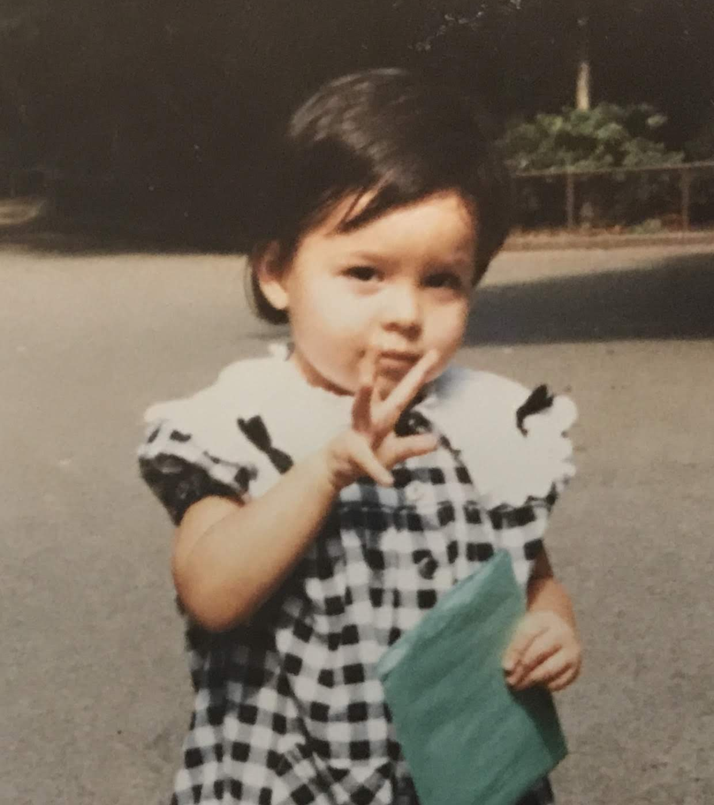
Mie Fukuda Futures Without Violence

Slide 11
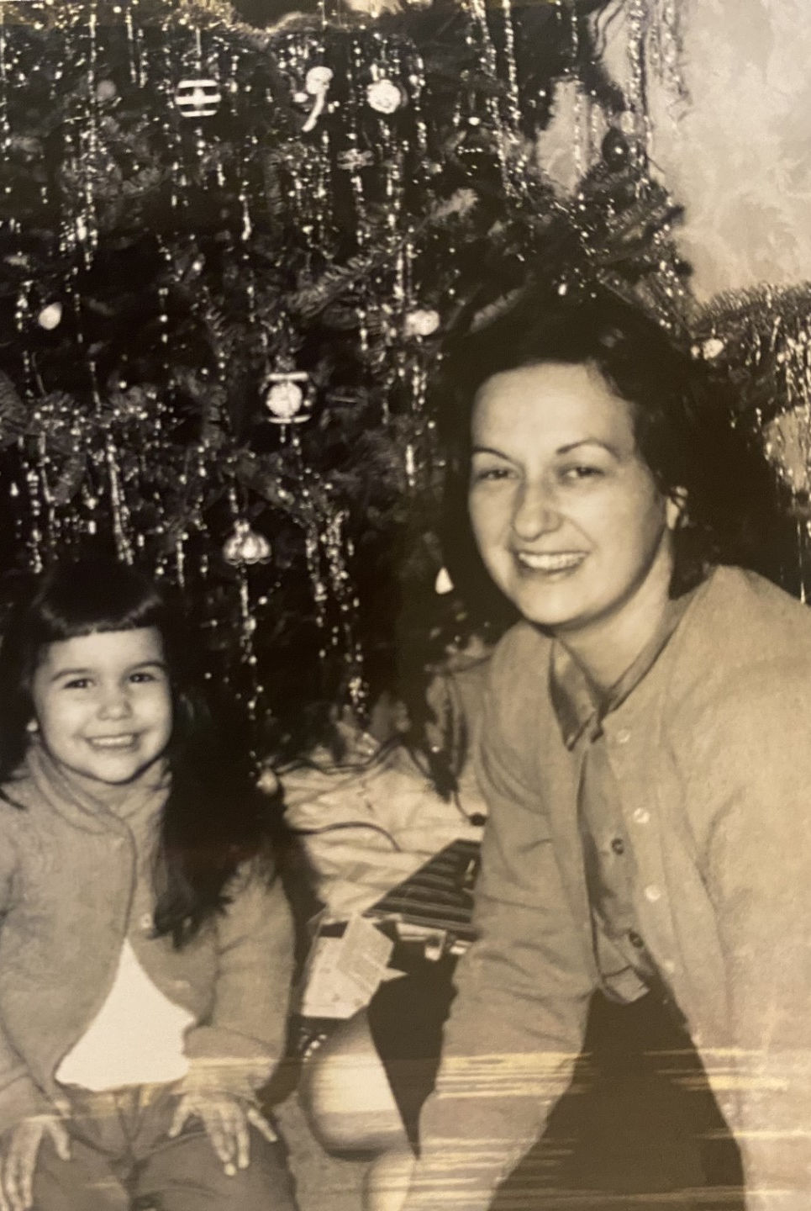
Lonna Davis Futures Without Violence

Slide 12
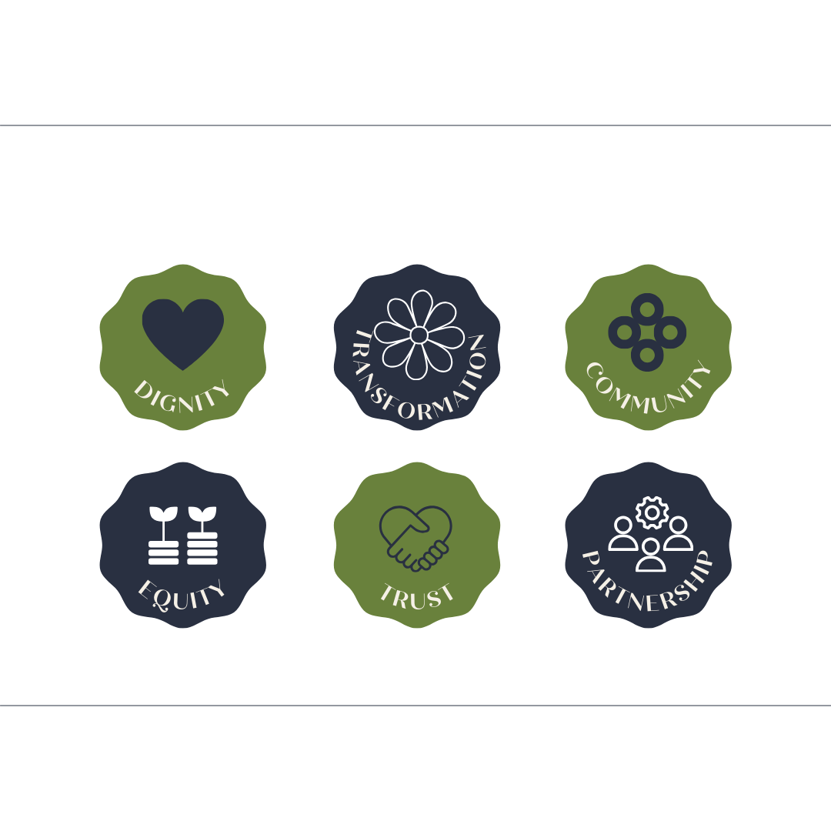
The values
that guide our
work and technical assistance
.

Slide 13
Technical Assistance and Training
Assisting in navigating complexities related to power, resources, and equity
Supporting children from the global majority who are exposed to domestic violence
Using creative activities and art to meaningfully engage with children, youth, and families
Addressing the interventions, prevention response and treatment of children and youth who are victims of and/or have been impacted by domestic violence, dating violence, sexual assault, and stalking
Understanding, integrating culture, anti-oppression, and intersectionality
Increasing language access and progressing toward linguistic justice
Building and maintaining transformational collaboration
Understanding and integrating culturally rooted, trauma informed healing
Creating and Sustaining Equitable
Youth Advisory Boards
Planning Phase Support
Notes:
Wendy will update this slide

Slide 14
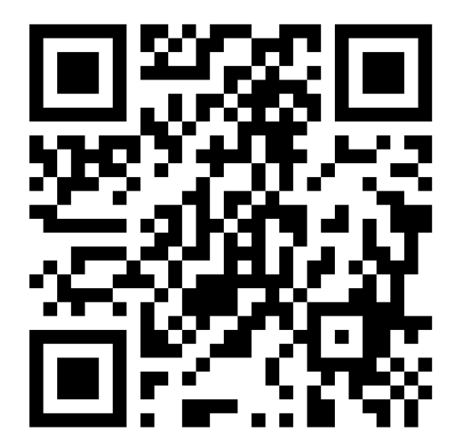
TA Contact Information:
Contact Us
thriveta@caminarlatino.org
www.thriveta.org
@caminarlatino | @4peaceandequity
(follow us on Instagram, Facebook, Twitter, and Linkedin)
Get in touch and stay connected!

